Slide 1
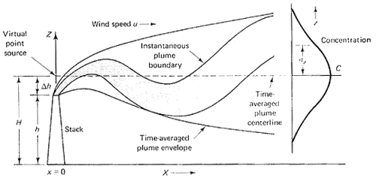
Point Source Gaussian Plume Model

Slide 2
The Gaussian point source dispersion equation relates average, steady-state pollution concentration to the source strength, wind speed, effective stack height and atmospheric condition
Assumptions:
The rate of emissions from the source is constant
The wind speed is constant both in time and with elevation
The pollutant is conservative; that is not lost by decay, chemical reactions or depositions and also when it hits the ground, none is absorbed, and all are reflected.
The terrain is relatively flat

Slide 3
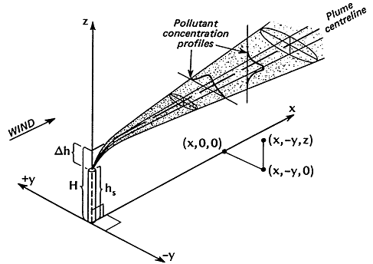
Plume dispersion coordinate system, showing Gaussian distribution in the horizontal and vertical direction (Turner, 1970)

Slide 4
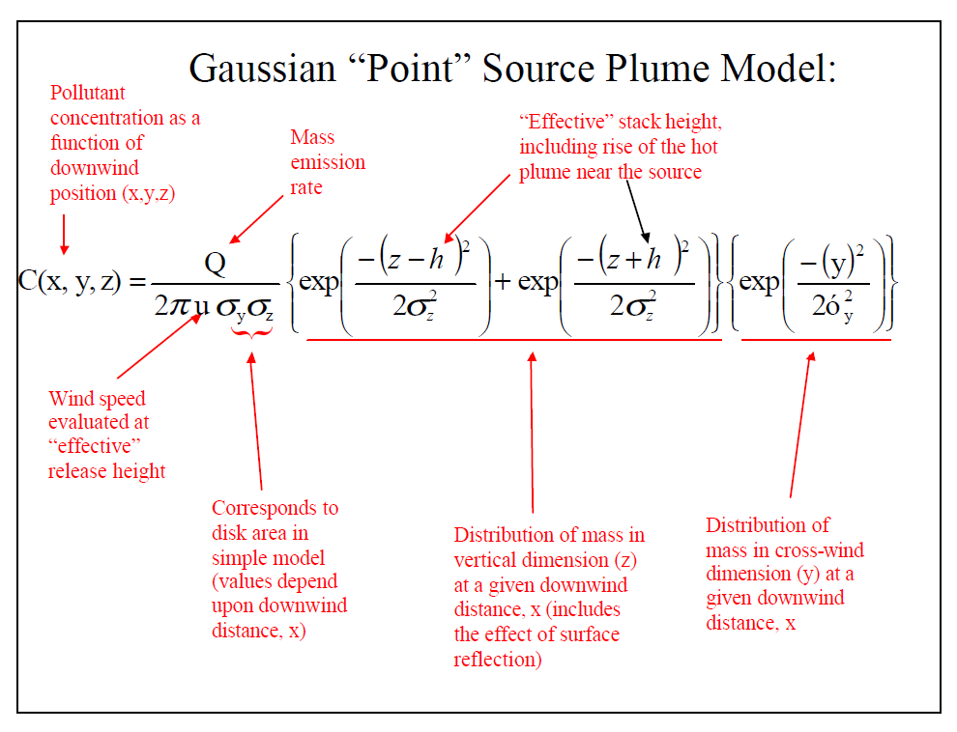

Slide 5

We are more interested in pollution concentration at the ground level
Putting z=0
The above equation is modified as
$$C\left(x,y\right)=\frac{Q}{πu_{H}σ_{y}σ_{z}}exp(\frac{{−H}^{2}}{2σ_{z}^{2}})exp(\frac{{−y}^{2}}{2σ_{y}^{2}})$$
C(x,y) – concentration at ground-level at the point (x,y) , μg/m³
X- distance directly downwind, m
Y- horizontal distance from the plum centerline, m
Q – emission rate of pollutants, μg/s
H – effective stack height, m
U_{H} – average wind speed at the effective height of the stack, m/s
σ _{y}, σ_{z} – horizontal and vertical dispersion coefficient (standard deviation), m

Slide 6
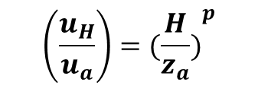
Changes in Wind Speed with Elevation
Usually the wind speed is measured at 10m height above the ground
We used the wind speed at effective stack height
How to find out the wind speed at the effective stack height?
Power law is used for calculating wind speed for elevation
$$\left(\frac{u_{H}}{u_{a}}\right)={(\frac{H}{z_{a}})}^{p}$$
Where, u_{H} – wind speed at elevation H
u_{a} – wind speed at anemometer height
H – Effective height of the plume
Z_{a} – anemometer height above the ground
p – a dimension less parameter that depends on surface roughness and atmospheric stability

Slide 7
Wind Profile exponent p, for rough terrain
Stability class | Description | Exponent P
A | Very unstable | 0.15
B | Moderately unstable | 0.15
C | Slightly unstable | 0.20
D | Neutral | 0.25
E | Slightly stable | 0.40
F | Stable | 0.60
For a smooth terrain multiply p by 0.6
Fall afternoon or cloudy summer day Or clear summer day sun at 15-35˚
Atmospheric stability classification
Clear summer day, sun at 60˚
summer day with few clouds
Surface Wind speed | Day solar Insolation |  |  | Night Cloudiness
 | strong | Moderate | Slight | Cloudy (>=4/8) | Clear (<=3/8)
<2 | A | A –B | B | E | F
2-3 | A-B | B | C | E | F
3-5 | B | B-C | C | D | E
5-6 | C | C-D | D | D | D
>6 | C | D | D | D | D

Slide 8
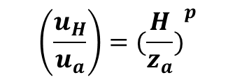
Example:
An anemometer at a height of 10m above ground measures the wind speed at 2.5m/s. Estimate the wind speed at an elevation of 300m in rough terin if the atmosphere is slightly unstable
Solution:
$$\left(\frac{u_{H}}{u_{a}}\right)={(\frac{H}{z_{a}})}^{p}$$

Slide 9
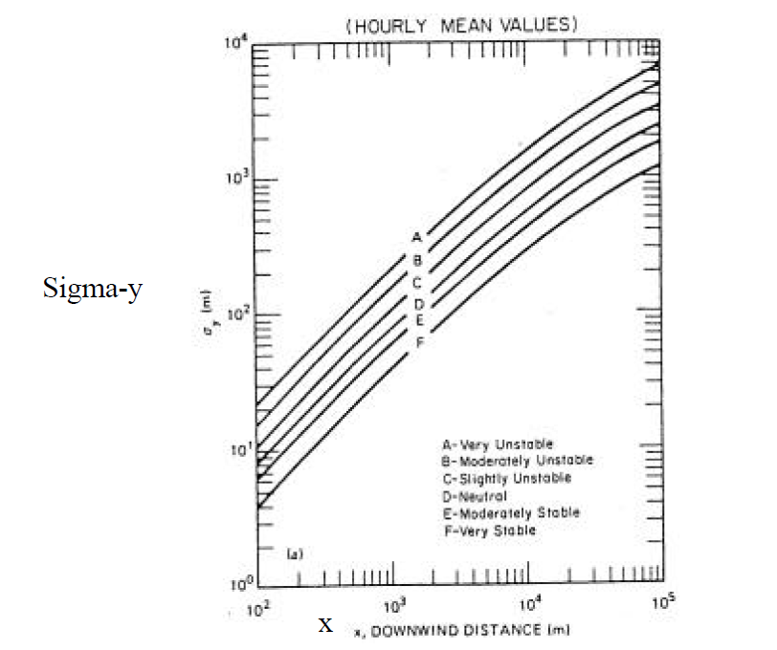
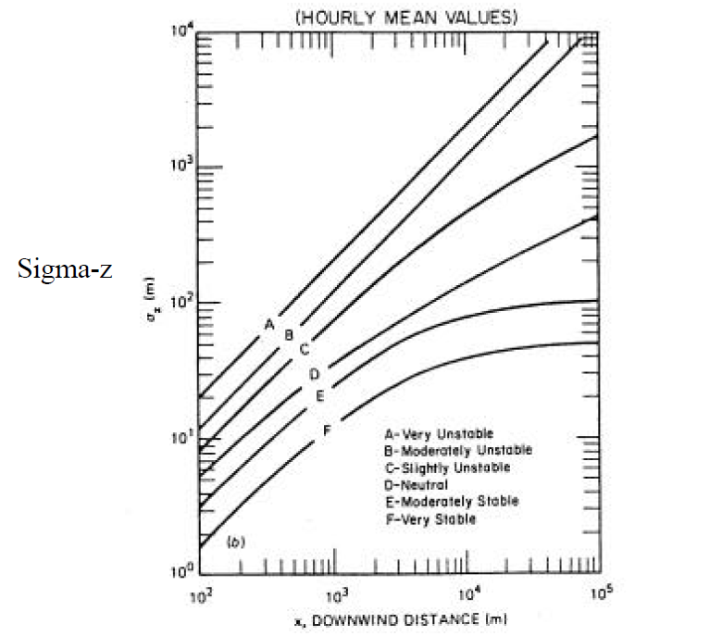
Gaussian Dispersion coefficients as a function of distance downwind

Slide 10
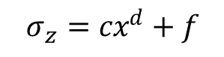
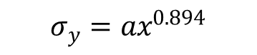
One way of finding σ _{y} , σ_{z} is (Martin, 1976)
$$σ_{y}={ax}^{0.894}$$
$$σ_{z}={cx}^{d}+f$$

Slide 11
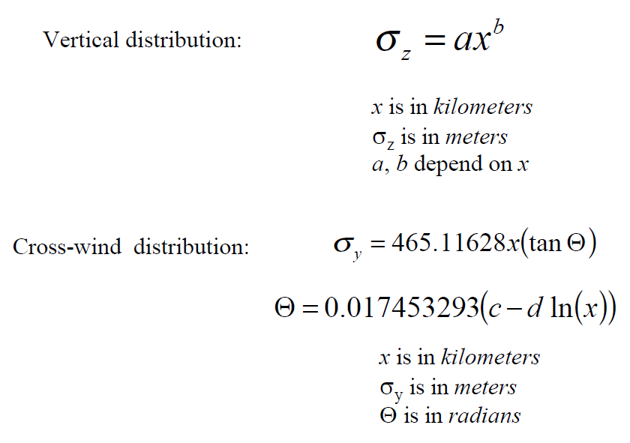

Slide 12
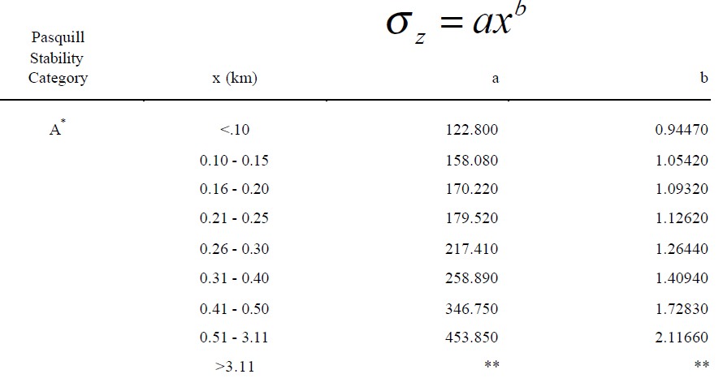

Slide 13
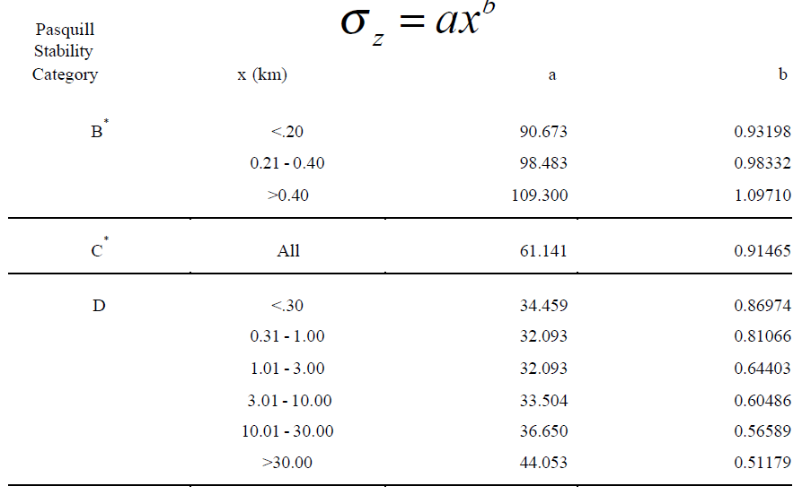

Slide 14
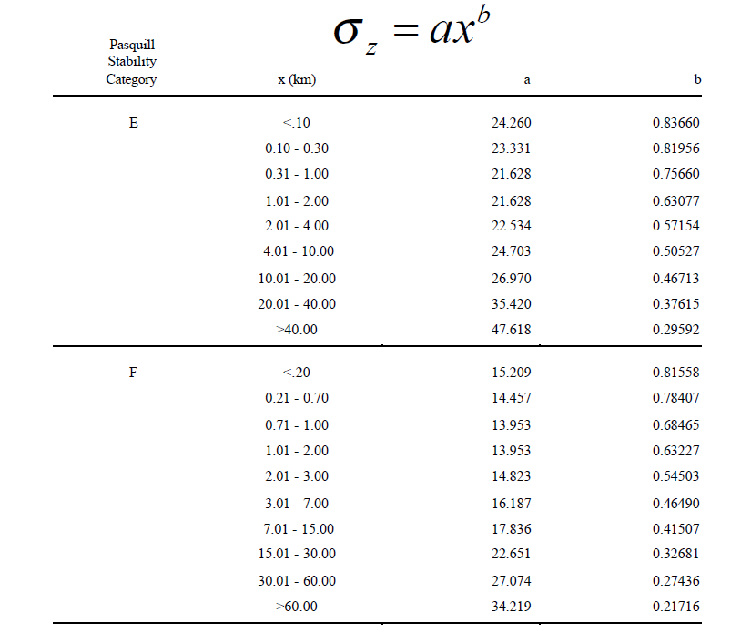

Slide 15
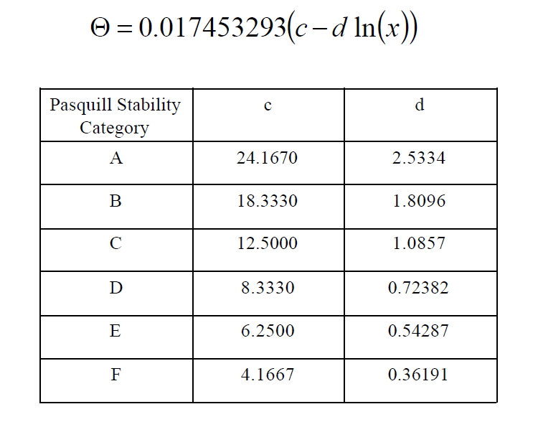

Slide 16

Downwind Ground-Level Concentration
The ground level concentration of pollution directly downwind of the stack is of interest since the pollution is highest along that axis
$$C\left(x,0\right)=\frac{Q}{πu_{H}σ_{y}σ_{z}}exp(\frac{{−H}^{2}}{2σ_{z}^{2}})$$
Example:
A 40 percent-efficient, 1000 MW (10⁶kW) coal-fired power plant emits SO₂ at the allowable rate of 0.6lb SO₂ per million Btu of heat into the plant. The Stack has an effective height of 300 m. An anemometer on a 10-m pole measures 2.5m/s of wind, and it is a cloudy summer day. Predict the ground- level concentration of SO₂ at 4 km directly downwind.

Slide 17
Peak Downwind Concentration
sensitive to the effective stack height
stability of the atmosphere (highest peak downwind concentration occurs in the atmosphere is very unstable)
stable atmosphere is worse than the unstable atmosphere beyond 14 km

Slide 19
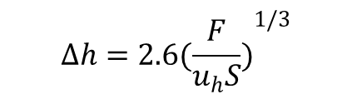
Plume Rise
Plume rise is the difference between the effective stack height (H) and the stack height (h)
The important factors affecting the plum rise are
Buoyancy
momentum of the exhaust gases
Stability of the atmosphere
Buoyancy flux Parameter
$$∆h=2.6{(\frac{F}{u_{h}S})}^{1/3}$$
Stability Parameter

Slide 20
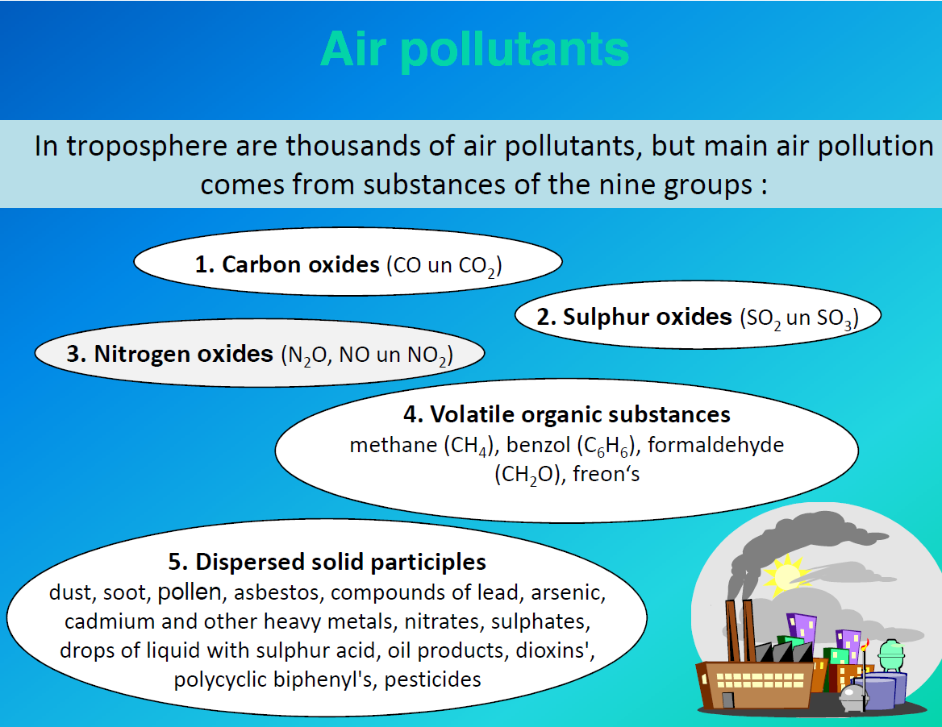
Plum Rise
Downwind concentration under temperature inversion
Line source Dispersion Model
Area source model or Box model

Slide 21
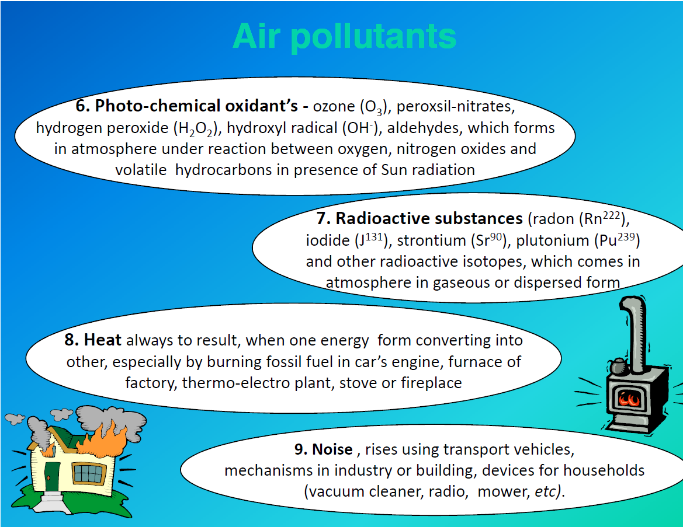

Slide 22
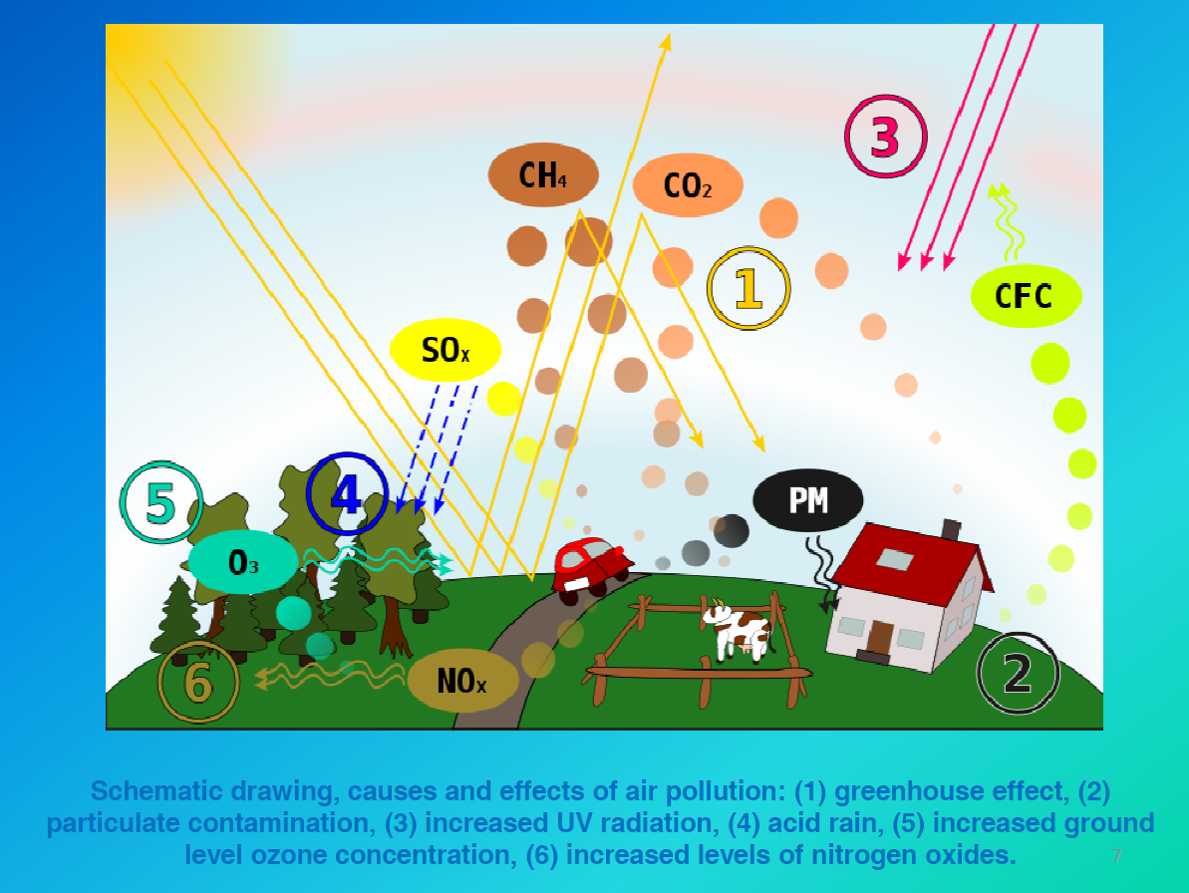

Slide 23
Motor Vehicle Emission
Air Pollutant
Emission from The thermal power Plant

Slide 24
Corporate average Fuel Economy (CAFÉ) Fuel Economy Standards
Federal Test Procedure (FTP) drive cycles defined for emissions were used to determine city and high fuel efficiencies, which are then weighted 55% city and 45% high to determine the over all fuel efficiency.
Example:
Fuel efficiency test indicates a particular automobile gets 20 mpg in the city and 29 mpg on the highway. What could be the CAFÉ fuel efficiency.
Solution:
In one mile of driving, the fuel efficiency could be
MPG= (1 mile)/{ (0.55miles/20 miles/gal)+(0.45 miles/29miles/gal))=23.2mpg

Slide 25
Otto Cycle Engine
Invented around 1880 by German engineer, Nicholas Otto

Slide 26
The most important factor in determining emissions from a four stroke, internal combustion engine is the ratio of air to fuel in the mixture as it enters.
Let us look at the gasoline combustion:
C₇H₁₃ + 10.25 O₂ – 7CO₂ + 6.5 H₂O
But in air always 3.76 moles of N₂ is associated with every mole of O₂
Thus with the air (10.25X3.73=38.54 mole of nitrogen can be placed
The combustion equation can be look like
C₇H₁₃ + 10.25 O₂ + 38.54 N₂ – 7CO₂ + 6.5 H₂O + 38.54 N₂

Slide 27
Example:
Deter mine the air –to-fuel ratio required for complete combustion of gasoline
As the reaction equation suggest
C₇H₁₃ + 10.25 O₂ + 38.54 N₂ – 7CO₂ + 6.5 H₂O + 38.54 N₂
Let us determine the mass of each constituent in the equation
1 mole of C₇H₁₃ = 7X14+13X1=97 g
10.25 mole of oxygen = 10.25X2X16 = 328 g
38.54 Mole of nitrogen = 38.54X2X14= 1079g
Air-fuel ratio
Air/Fuel = (328+1076)/97=14.5

Slide 28
If the air less present – the mixture is said to be rich
If the air is more - the mixture is said to be lean
rich mixture produces more CO and unburned HC
Lean mixture reduces CO and HC
Rich mixture- lack of oxygen – lowers the combustion temp – reduce NOx
Beyond certain point lean mixture have excesses air that dilution lowers flame temperature and also reduces NOx

Slide 29
Other factors affecting the emission of pollutants
Ignition timing
Compression ratio
Combustion chamber geometry
Vehicle is idling, accelerating, cruising etc.
Not all pollutants created in the combustion chamber makes its way to exhaust, some found around the piston during the power and compression stroke, into the crankcase. This is called blowby.
Positive crankcase ventilation (PCV)

Slide 30
Two-Stroke Engine

Slide 31
Diesel Engines
Diesel engines have no carburetor since the fuel is injected directly into the cylinder
There is no conventional ignition system with plugs, points and condenser since the fuel ignites spontaneously during the compression stroke
Diesels have much higher compression ratios than conventional (Otto cycle) engine
They run in very lean mixture (do not depend on spark ignition)
More fuel efficient
Emission of carbon-dioxide, CO is low
NOx emission is relatively high
it emits significant quantity of carbonaceous shoot particles

Slide 32
Auto-emission control
To control CO and HC involves air injection into an enlarged exhaust manifold to encourage continued oxidation after these gases left the combustion chamber
exhaust gas can be recirculate into the air/fuel mixture
Three way catalytic convertor

Slide 34
Three way catalytic convertor (CO, HC and NOx)

Slide 35
Other way of reducing emission
Use of
Cleaner Gasoline
Ethanol
Methanol
Biodiesel
Compressed Natural Gas (CNG)
Electric-Drive Vehicles

Slide 36
Ethanol (CH3CH2OH)
It reduces the CO emission
It is formed from the fermentation of sugarcane (Brazil) or from corn (USA)
Ethanol can be blended with gasoline (Gasohol)
blending can be in 10% Ethanol+ 90% Gasoline (E10)
85% Ethanol+ 15% Gasoline (E85)
In terms of CO2 emission balances the atmospheric CO2
Disadvantage:
E85 have significant higher emissions of organic gages like formaldehyde and acetaldehyde which leads to ozone-related mortality

Slide 37
Methanol (CH3OH)
Prepared from wod
Fuel for high-performance racing Cars
Produces higher compression ratios so NOx is reduces
also CO and HC emission is reduced
Disadvantage
much emission of formaldehyde
Difficult start ignition in cold condition as it is low volatility (can be over come by M85)

Slide 38
Biodiesel
It prepared from vegetable oil, animal fats etc.
Less sulfur emission
Can be blended as B2, B5, B20
Disadvantage
In appropriate for cold climate

Slide 39
Reduction of Emission from Stationary Sources
There are Three ways to do it
Increase conversion efficiency from fuel to energy
Increase efficiency with which energy is used
Substitute less polluting sources

Slide 41
Precombustion Controls
Fluidized-Bed Combustion (FBC)

Slide 42
Particulate Control

Slide 43
Baghouses

